Slide 1
ULI101: Introduction to Unix / Linux and the Internet Week 4: Lesson 1 data representation numbering conversion
Photos and icons used in this slide show are licensed under CC BY-SA

Slide 2
Lesson 1 topics
Data Representation
Purpose
Decimal, Binary, Octal, Hexadecimal Numbering Systems
Numbering Conversion Methods
Demonstration
Perform Week 4 Tutorial
Investigation 1
Review Questions (Questions 1 – 5)

Slide 3
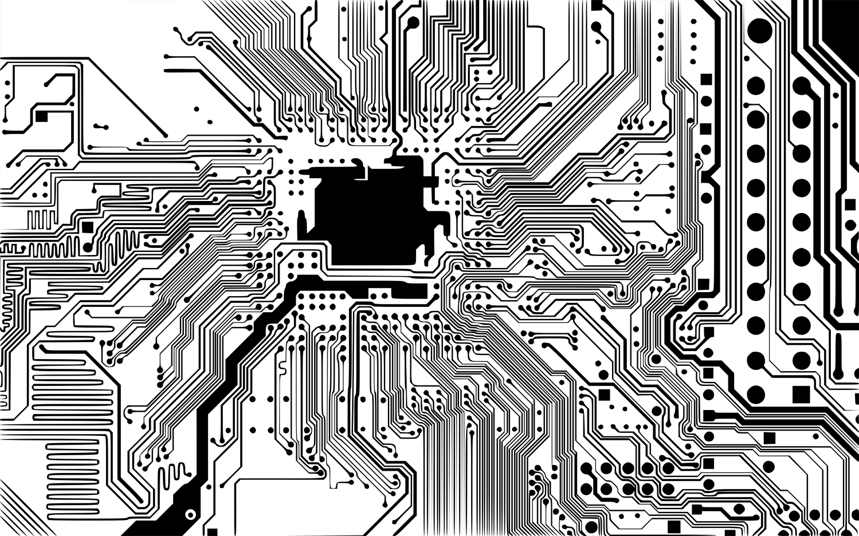
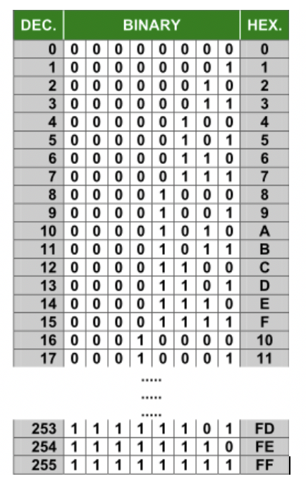
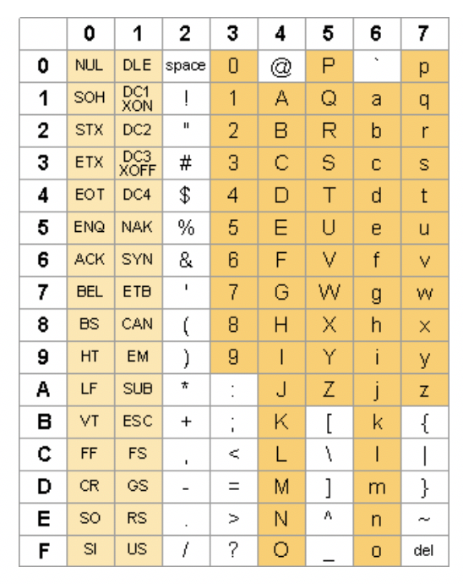
Data Representation
Data Representation Digital computers are electronic devices that contain a series of circuits and voltage levels that can store / represent data.
Binary numbers can represent those series of circuits with voltage levels. Those binary numbers (0’s and 1’s) are combined in a sequence to form a byte.
Bytes are used to represent numbers or characters.
It is the job of the computer program to understand if those bytes (series of o’s and/or 1’s) represent numbers or characters (eg. in C programming, declaring a variable with a data type)
Understanding how the computer stores numbers and characters can be useful when administrating computer systems and creating programs to be run on computer systems.

Slide 4
Data Representation
Numbering Conversion:
Computers have evolved over time. During that time, humans have interfaced with the computer by binary numbers, or by using short-cuts such as octal or hexadecimal numbers.
Computer Networking / Support Specialists and Computer Programmers occasionally need to convert between numbering systems:
Converting decimal numbers to binary number for URLs (subnetting)
Converting decimal numbers to hexadecimal numbers to format webpages (with web-safe colours)
Converting binary numbers to octal numbers for setting file permissions in Unix/Linux
Before performing numbering conversions, we need to better understand the decimal, binary, octal and hexadecimal numbering systems.

Slide 5

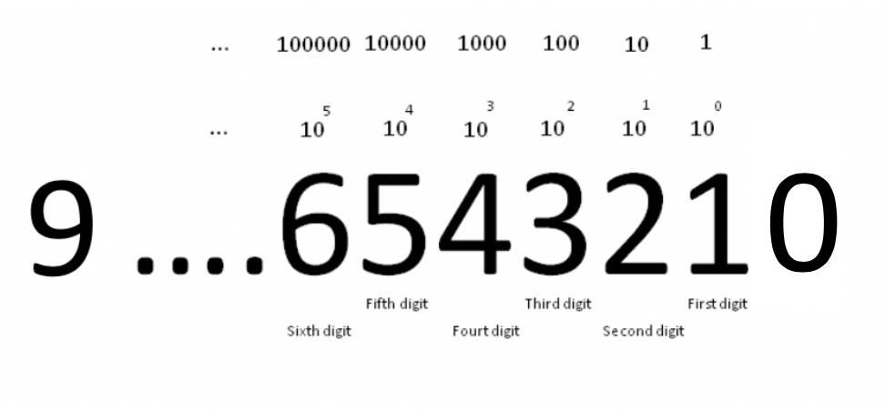
Data Representation
Decimal Numbering System (Humans)
The numbering system used by humans.
The decimal numbering system consists of digits ranging from 0 to 9.
The fact that humans started counting on their fingers and thumbs most likely lead to the development of this numbering system.
The decimal numbering system is based on sums of the power of 10 which provides a framework for mathematic calculations.

Slide 6

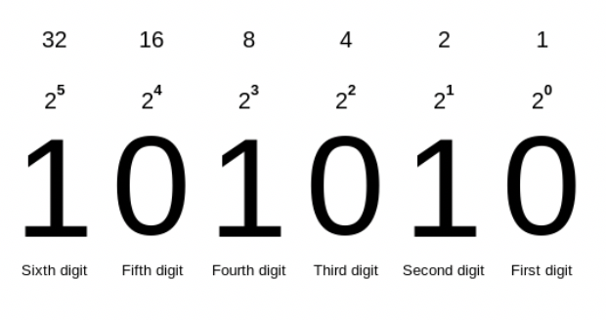
Data Representation
Binary Numbers (Computers)
Digital computers have circuits which representing data in terms of voltage levels. Multiple circuits are used to represent data (in the form of binary numbers).
The binary numbering system consists of digits ranging from 0 to 1. The numbering system is based on sums of the power of 2.
Referring to the diagram to the right, the value of each decimal digit consists of the value (placeholder) multiplied by the corresponding power of 2. For example, 2⁰ , 2¹, 2², etc. which move in a right-to-left direction.

Slide 7
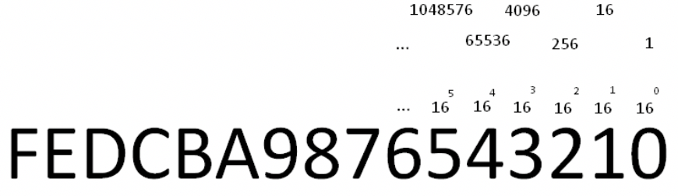
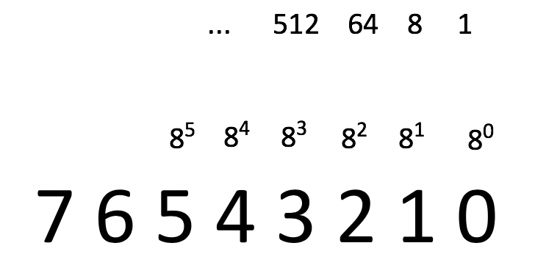
Data Representation
Octal / Hexadecimal Numbers (short-cuts)
The octal and hexadecimal numbering systems consist of digits ranging from 0 to 7 and ranging from 0 to F respectively.
The octal and hexadecimal numbering system are based on sums of the power of 8 and 16 respectively. For hexadecimal numbers, values for 10 to 15 are represented by the characters A to F respectively.
These numbering systems are useful since they are both multiples of 2 (binary) and can be used as short-cuts to represent a series of binary numbers:
1 octal digit = 3 binary digits
1 hexadecimal digit = 4 binary digits).

Slide 8
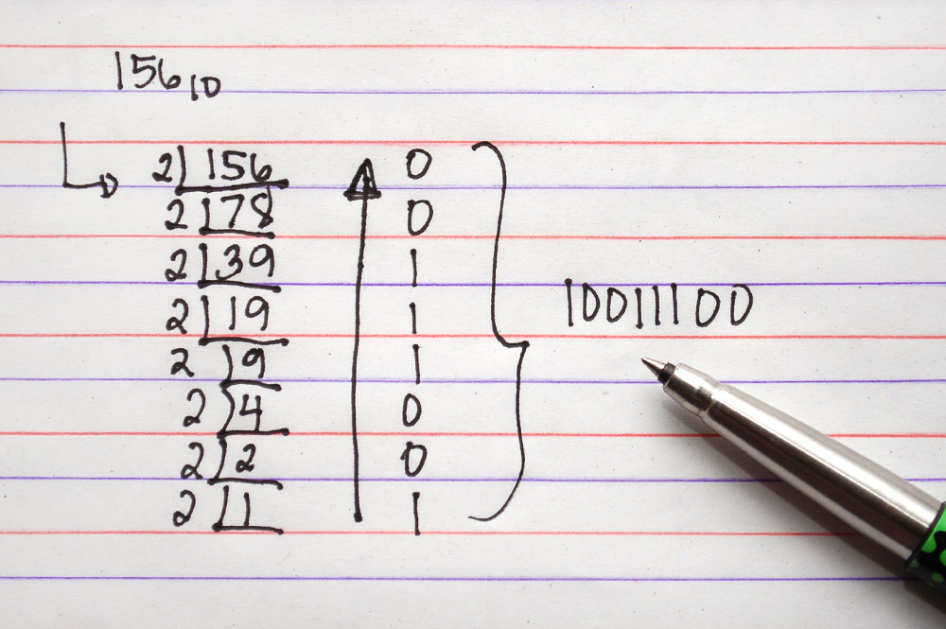
Data Representation
Performing Numbering Conversion You will learn several numbering conversion methods in this course:
Binary to Decimal
Decimal to Binary
Octal to Binary / Binary to Octal
Hexadecimal to Binary / Binary to Hexadecimal
Octal to Hexadecimal / Hexadecimal to Octal
NOTE: Each of these techniques are unique. You will be expected not only to perform these calculations on a quiz / midterm exam / final exam but also show your work and use the same technique show in these slides to obtain full marks.

Slide 9
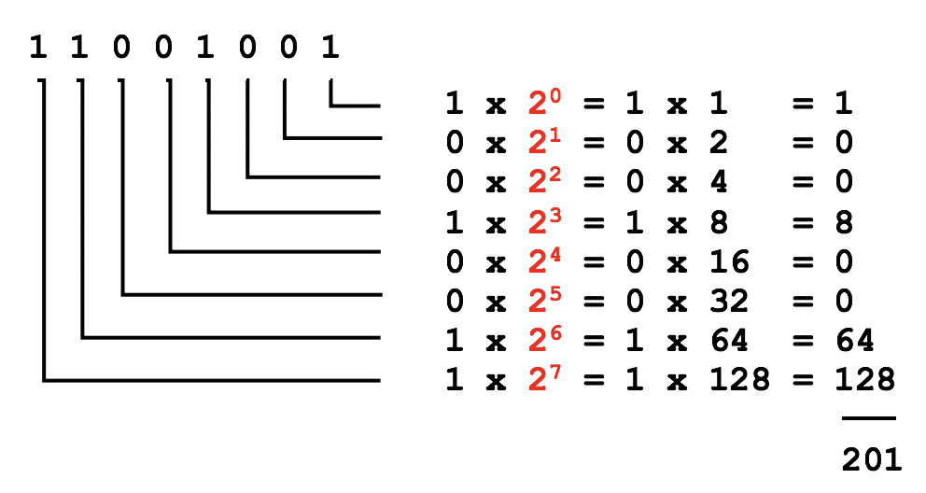
Data Representation
Numbering Conversion Method 1: Binary to Decimal
When converting binary numbers to decimal numbers, perform the following steps:
Write down the binary number.
Starting from the right-side, draw L's below the binary number moving to the left (refer to diagram on right).
Starting on the rightmost "L", multiply the value (placeholder) by 2 to the power of zero.
Continually repeat step #3 moving leftwards, increasing the power of 2 by 1(refer to diagram on right).
Add up the results to obtain the decimal value equivalent.
NOTE: To convert octal and hexadecimal numbers to decimal, replace the number 2 (in red in the diagram to the right) with 8 (for octal) or 16 (for hexadecimal).

Slide 10

Data Representation
Instructor Demonstration
Your instructor will now demonstration how to perform a Binary to Decimal conversion

Slide 11
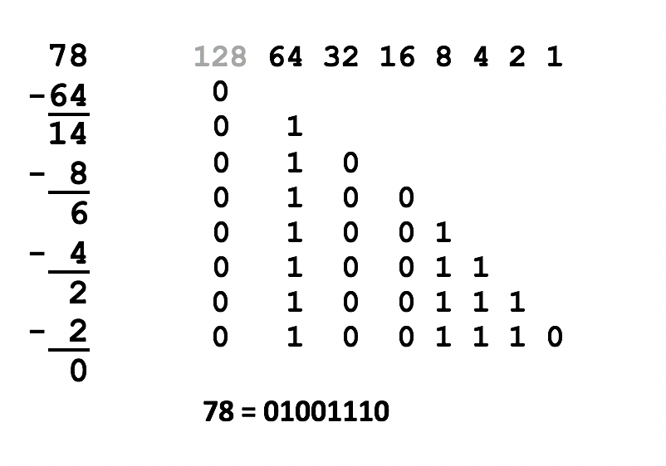
Data Representation
Numbering Conversion Method 2: Decimal to Binary
When converting decimal numbers to binary numbers, perform the following steps:
Write down the decimal number to be converted.
On the right-side, write the number 1 and moving leftwards, keep doubling the numbers until that number is greater than the decimal number to be converted (refer to the diagram on the right).
Starting on the left-side of those doubled numbers, compare that number with the decimal number. If that number if less than or equal to the decimal number, then write a 1 below and subtract that number from the decimal number to get a remainder. If the number is greater than decimal number (or remainder), then write a 0 below.
Repeat step #3 (moving rightwards and comparing the number with the decimal's remainder) NOTE: If you are converting to 8-bit, 32-bit, etc., add leading zeros if necessary.

Slide 12
Data Representation
Instructor Demonstration
Your instructor will now demonstration how to perform a Decimal to Binary conversion

Slide 13
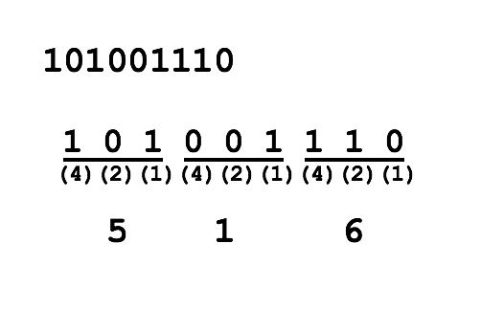
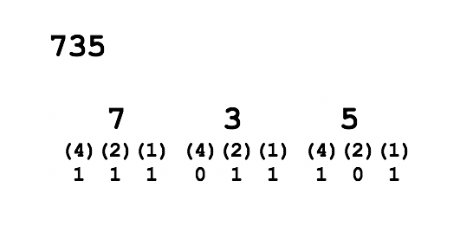
Data Representation
Numbering Conversion Method 3: Octal to Binary / Binary to Octal
Binary to Octal
One octal number represents 3 binary numbers, so starting from right-side, group binary digits into groups of 3 (add leading zeros if necessary).
Write (4)(2)(1) under each group of 3 binary numbers.
Multiply the value or "placeholder" (i.e. 0's and 1's) by the corresponding (4)(2)(1) for each group to obtain the octal number (refer to diagram of binary to octal conversion).
Octal to Binary
One octal number represents 3 binary numbers, so space-out the octal numbers to make space for a binary number.
Write (4)(2)(1) under each octal number.
Write 0's or 1's for each group of binary numbers to add up to the corresponding octal number (refer to diagram of octal to binary conversion).

Slide 14
Data Representation
Instructor Demonstration
Your instructor will now demonstration how to perform an Octal to Binary conversion and a Binary to Octal conversion.

Slide 15
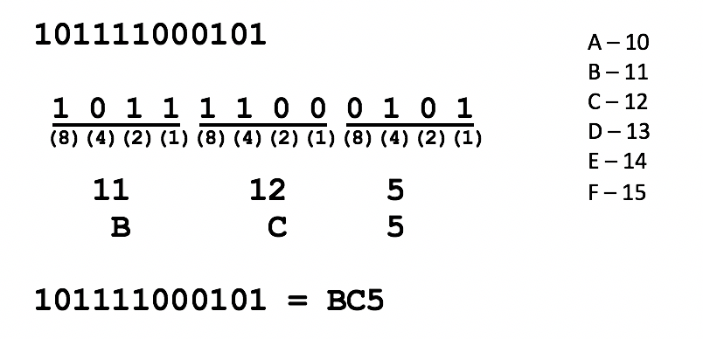
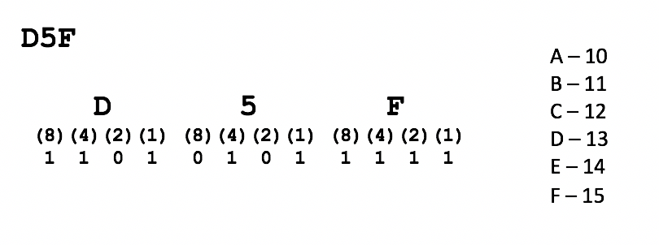
Data Representation
Numbering Conversion Method 4: Hexadecimal to Binary / Binary to Hexadecimal
Binary to Hexadecimal
One hexadecimal number represents 4 binary numbers, so starting from right-side, group binary digits into groups of 4 (add leading zeros if necessary).
Write (8)(4)(2)(1) under each group of 4 binary numbers.
Multiply the placeholders (i.e. 0's and 1's) by the corresponding (8)(4)(2)(1) for each group to obtain the octal number.
Convert values from 10 to 15 to A to F (refer to diagram of binary to hexadecimal conversion)
Hexadecimal to Binary
One hexadecimal number represents 4 binary numbers, so space-out the hexadecimal numbers to make space for a binary number.
Convert letters A to F to 10 to 15 (refer to diagram of binary to hexadecimal conversion)
Write (8)(4)(2)(1) under each hexadecimal number.
Write 0's or 1's for each group of binary numbers to add up to the corresponding hexadecimal number (refer to diagram of hexadecimal to binary conversion).

Slide 16
Data Representation
Instructor Demonstration
Your instructor will now demonstration how to perform a Hexadecimal to Binary conversion and a Binary to Hexadecimal conversion.

Slide 17
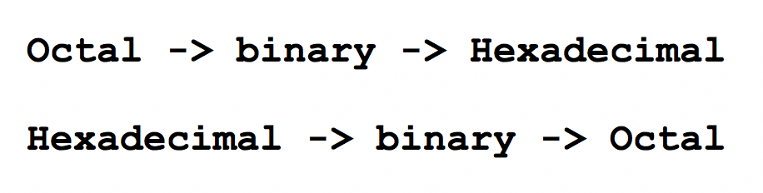
Data Representation
Numbering Conversion Method 5: Octal to Hexadecimal / Hexadecimal to Octal
To convert using the method, simply use binary as a "bridge".
Example:
To convert octal to hexadecimal, convert octal to binary, then convert binary to hexadecimal.
To convert hexadecimal to octal, convert hexadecimal to binary, then convert binary to octal.

Slide 18
Data Representation
Instructor Demonstration
Your instructor will now demonstration how to perform an Octal to Hexadecimal conversion and a Hexadecimal to Octal conversion.

Slide 19
HOMEWORK
Getting Practice
Perform Week 4 Tutorial (Due: Friday Week 5 @ midnight for a 2% grade):
INVESTIGATION 1: NUMBERING CONVERSIONS
LINUX PRACTICE QUESTIONS (Questions 1 – 5)

